Slide 1

Hybrid Cloud Management Services on the IBM Services Platform with Watson
Overview
© 2017 IBM Corporation

Slide 2
Agenda
IBM Services Platform with Watson
IBM Journey to the Era of Cognitive IT
ITaaS: Hybrid Cloud Management Services
A Deeper Dive into Broker and ICDS

Slide 3
Introduction to the IBM Services Delivery Platform with Watson

Slide 4
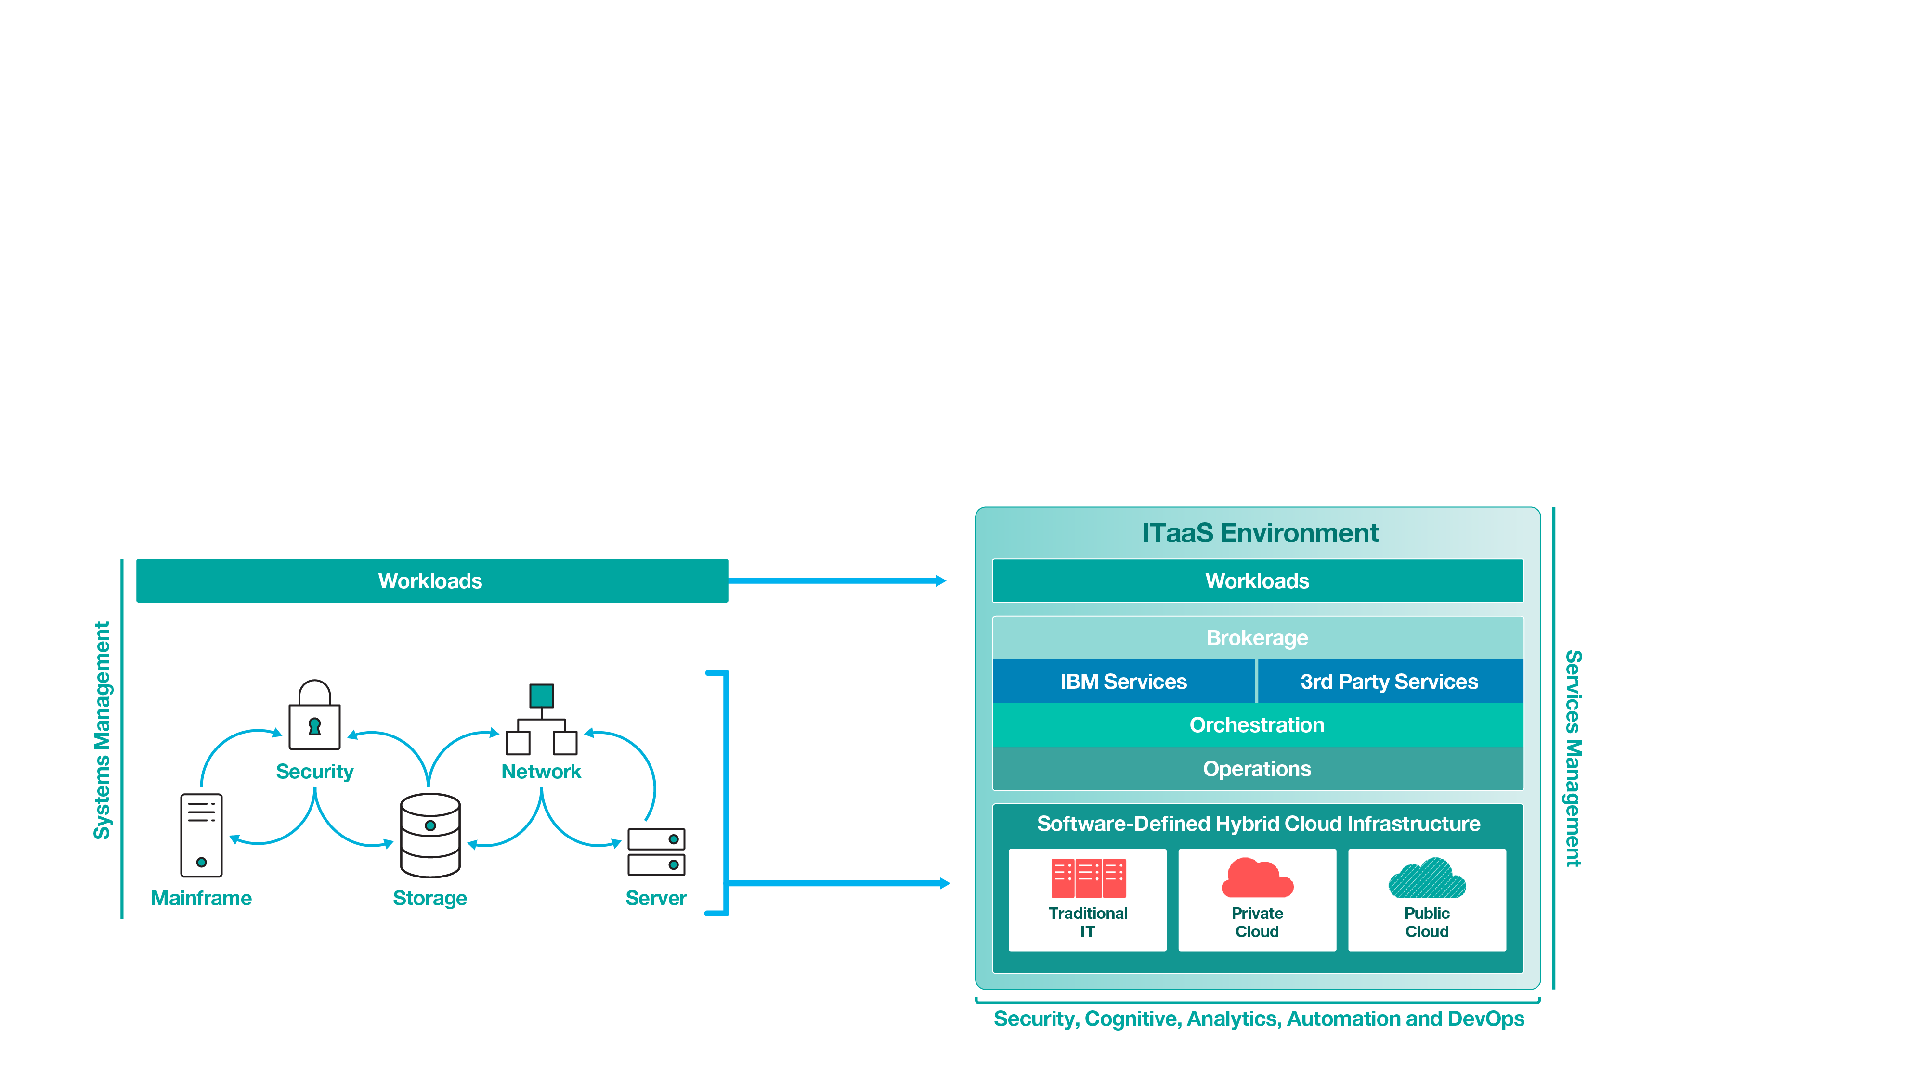

As traditional IT becomes software-defined and the “as a service” paradigm takes hold, a new model is required
From: Systems Integration
To: Services Integration
ITaaS Environment
Workloads
Consumable Services
Brokerage
Orchestration
Operations
Traditional On-premises IT Client-based
Private Cloud Client-based
Public Cloud Other, etc.

Slide 5

By integrating services with IBM’s ITaaS model, you can design, build and run your entire environment as one end-to-end infrastructure.
Design, build and run always on platforms
for business workloads…
Business Solutions
Workloads for
Customer-facing Solutions
Workloads for
Business Partner Solutions
Workloads for
Workforce Enablement Solutions
Consumable IT Services and Apps
IBM Services
3rd Party Services
Cloud
Mobility
Network
Resiliency
3rd Party Service
3rd Party Service
3rd Party App
Systems
Support
Security
IBM App
3rd Party Service
3rd Party
Service
Client App
...by assembling
the optimal mix of
IBM and 3rd party services...
Brokerage
Orchestration
Operations
...which run across robust traditional IT
and cloud platforms.
Hybrid Cloud Infrastructure
Traditional On-premises IT Client-based
Private Cloud Client-based
Public Cloud IBM
Public Cloud AWS
Public Cloud Azure
Public Cloud Other, etc.
Analytics, Cognitive, Automation, DevOps & Security

Slide 6




The next step of our Journey requires Cognition
From: Practitioner-run, technology-assisted
To: Technology-run, practitioner-assisted
From (2016)…
…To (2017+)
Client
IT Outcomes
Client
Service Outcomes
Practitioners
Technology
Technology
applied to
simple tasks
Practitioners manage
complex tasks
Technology
Practitioners
Data-driven insight for execution
Autonomic system to understand, reason, and learn
Analytics
Cognitive
From account-centric processes to standard processes across accounts executed by practitioners…
Talent required for medium and complex tasks, with automation of simple tasks
End-to-end activity and deliverable planning within pre-defined structures
…to standard processes across accounts executed by technology, with use of data for differentiated insights
Automation, with a highly skilled workforce focused on complex tasks
Talent and organization using Agile methodologies and structures (e.g., squads / tribes / guilds)

Slide 7
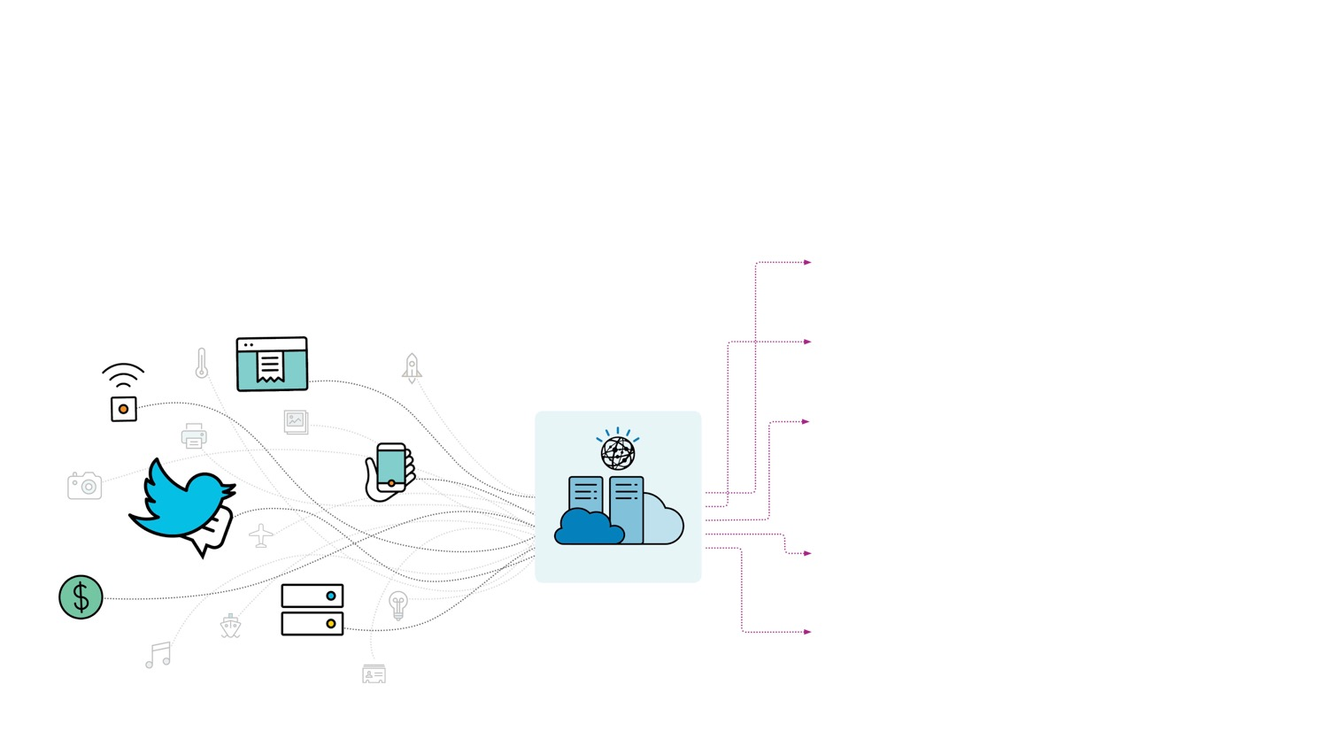
Leveraging cognitive insights from an growing source of data, enables optimization and shift in focus.
When your cognitive infrastructure runs itself, it can:
dramatically reduce practitioner error
uncover new ways to improve service quality through cognitive insights
Support
ticket data
Sensor data
Cognitive Infrastructure
deliver unmatched, automated infrastructure flexibility
Mobile
device data
So you, the tech leader, can:
Social media data
focus more on new market-changing innovations
Cognitive infrastructure
Transaction data
use cognitive advice to rapidly design superior solutions for making your new ideas real
Server data

Slide 8
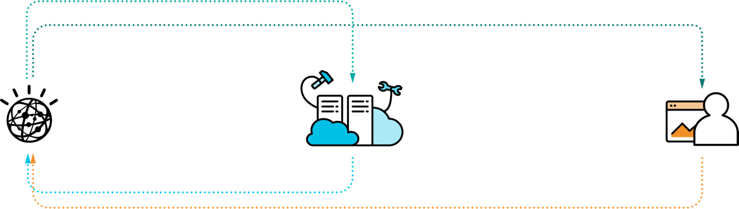
Insights can be leveraged in a closed loop across automated operations and experts within the ITaaS environment.
Directives
Insights and advice
Watson
understands, reasons and learns from data
Automation
executes tasks
Experts
make strategic decisions
Performance data
Imperatives
Managing services operations
to keep the environment healthy and always-on
Optimizing services performance
to improve business outcomes
Designing superior solutions
to deliver on business objectives

Slide 9

IBM Services Platform with Watson
Client Insight Dashboards
Build an agile ITaaS environment to meet ever-changing business needs by:
Building a robust catalog of offerings to take full advantage of modular services from both IBM and ecosystem partners
Seamlessly integrating services, at scale to drive adaptability of your IT and accelerate innovation.
Establishing end-to-end governance to reduce waste and sprawl through policy controls over all costs and assets
ITaaS Environment
IBM Watson
Cognitive Solution Designer
Business Solutions
Automated Services Manager
Composable Services
Cognitive Services Optimizer
Traditional IT
Private Cloud
Public Cloud
IBM’s Data Lake
Ensure your environment is always on, always secure, always improving by focusing Watson on three main objectives:
Designing superior IT solutions to more rapidly and effectively deliver on business objectives
Managing IT operations to keep the environment healthy and always-on
Optimizing IT performance to continuously improve business outcomes

Slide 10
ITaaS: Hybrid Cloud Management Services...

Slide 11





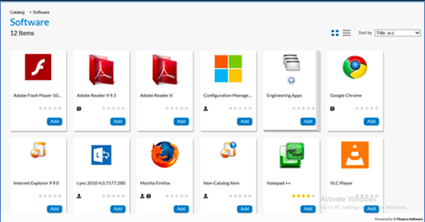
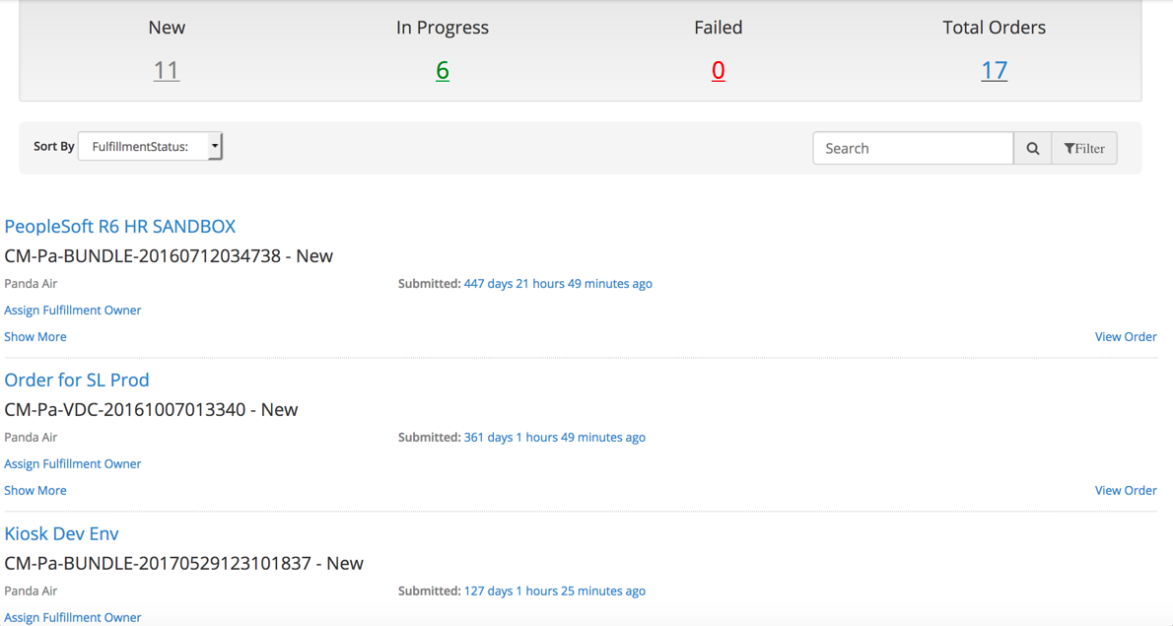
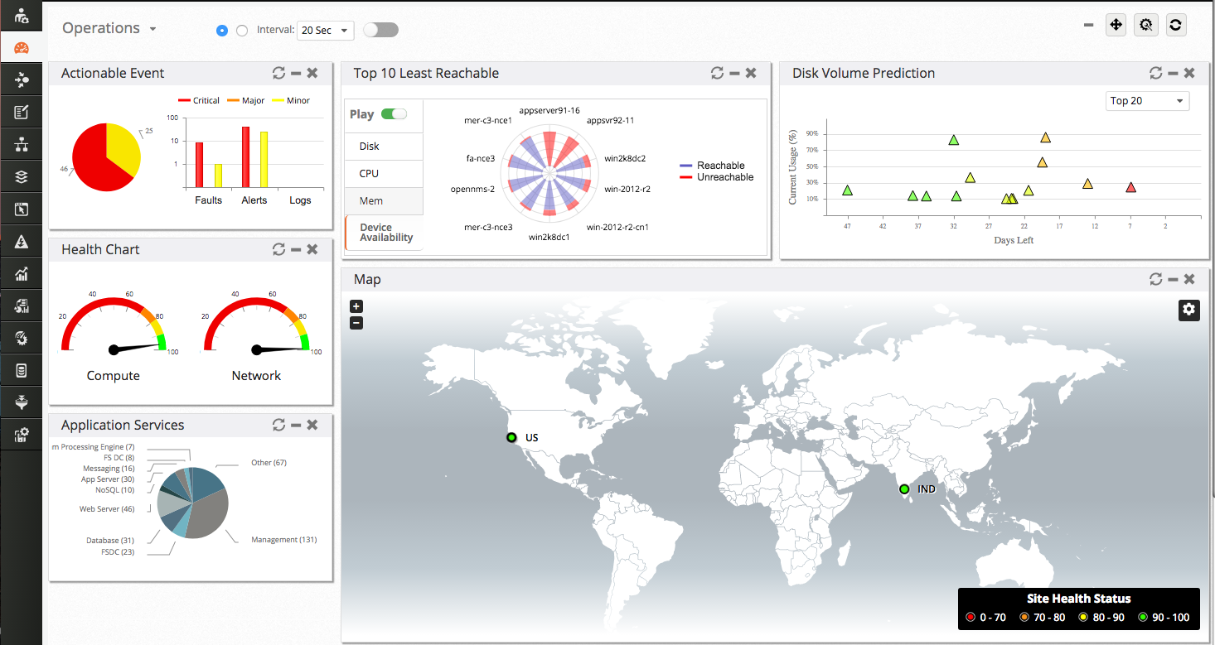
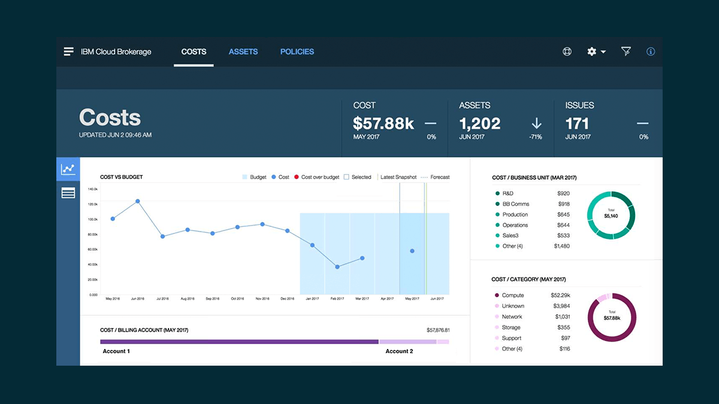



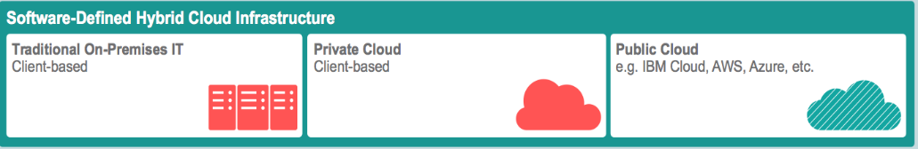
HCMS: An Offering Solution Bundle on the Platform
Strategic Initiative for 2018
Sandy
(Solution Architect)
George
(LOB Consumer)
Jack
(Financial Analyst)
Integrated Self Service
Insights
PLAN
MIGRATE
BUY
INTEGRATE
OPERATE
GOVERN
Data
Service Fulfillment
Carl
(Content Developer)
Consumption
Ops Management
Governance
Brokerage
Client’s requiring solutions for Hybrid Cloud are most often as needing the “Bundle” that includes Broker, ICDS and IMI Offerings + Integrations
Today, client solution designs that include multiple independent, yet related offerings are complex, costly and slower to complete than a ’bundle’ (Solution)
HCMS is required for competitiveness in the the growing Hybrid Cloud Market
Planning
Storefront
(Catalog)
Cost & Assets
Finance
(Ops Mgmt)
Orchestration (ICDS)
Pattern
Factory
Patterns
Workflows
SW Configuration Management
Managed Services (IMI)
Monitor
Events
Patch
Automate
ITSM (IPC)
Michael
(IT Ops/Admin)

Slide 12


Hybrid Cloud Management Services
GTS Service Offering Overlay - Today
Sandy
(Solution Architect)
George
(LOB Consumer)
Jack
(Financial Analyst)
Carl
(Content Developer)
Brokerage
IBM Brokerage Services Application Suite
GTS Offerings are much more then technology, they are managed services with a delivery and operational models provided by IBM
Offerings include/use and are based on technology and are IP driven using best of bread IBM and 3rd party Software
Planning
Storefront
(Catalog)
Cost & Assets
Finance
(Ops Mgmt)
Pattern Factory
Orchestration
IBM Cloud Deployment Services
Patterns
Workflows
SW Configuration Management
Operations
IBM Integrated Managed Infrastructure Services
Michael
(IT Ops/Admin)
Monitor
Events
Patch
Automate
ITSM (IPC)
12

Slide 13
Hybrid Cloud Management Services
Technology Overlay and Choices - Today
Sandy
(Solution Architect)
George
(LOB Consumer)
Jack
(Financial Analyst)
Carl
(Content Developer)
Brokerage
We don’t sell just technologies in GTS, we sell services that use technologies to delivery the highest value to the client.
We lead with IBM technologies in our services when they are the best fit
We are standardizing on more prescriptive and certified ‘stacks’ that enable repeatability and scale with the quickest time to value for the client.
IBM Cloud Broker Platform + Applications
Planning
Storefront
(Catalog)
Cost & Assets
Finance
(Ops Mgmt)
Pattern Factory
Orchestration
IBM Cloud Private (including CAM)
Patterns
Workflows
SW Configuration Management
VMware vRealize
Operations
Nagios
ICD
Monitor
Events
Patch
IPCenter
Michael
(IT Ops/Admin)
ITM
NetCool
IEM
Automate
ITSM (IPC)
ServiceNow
13

Slide 14
HCMS: Integration with IBM Services Platform with Watson
Key Focus Areas for 2018
DevOp and Platform Hosting
ISPW Regional ICP Hosting
Broker DevOps for Cloud Native
Common Services
IAM Services, Logging, etc.
Data and AI Services
Integration of CDI, IMI, BCAM
AI Operations
Console Integration
AI Operations
Platform Portal
HCMS Portal
4
Platform
DevOps
Brokerage Applications
IBM Watson
Design
Manage
Orchestration (ICDS)
Optimize
Customer DevOps ToolChain
Operations (IMI)
1
3
Customer’s Workloads
IBM’s Data Lake
Customer’s Enterprise Systems
2
Common Services (IAM, Data Services, AI Services)
ISPW Deployment Platform (SDE: Server, Storage, Network, Containers)
1
VMware
ICp
GTS Shared Managing Environment
Client Dedicated Manage-From Environment
Client Manage-To Environment
14

Slide 15
A closer look at the consumption and management of Hybrid Cloud

Slide 16
Hybrid Cloud is a Reality Today
The reality of Hybrid Cloud has Introduced Key Challenges that can addressed with an ITaaS Services Model
Consuming the most appropriate services for a given application and workload
Lack of Visibility & Control across growing numbers of service providers
Shadow IT with LOBs leveraging the Cloud and bypassing Central IT
Integration of a multitude dimensions (e.g. multiple providers, service management)
Supporting and Managing multi sourced IT Infrastructure
LOB needs for
Speed and Flexibility
Central IT needs for
Visibility and Control

Slide 17
Hybrid Cloud Requires a New Focus: Enterprise IT as a Broker
Becoming a cloud broker requires a more business centric approach with an ITaaS operational model.
Traditional IT
Hybrid Cloud
Business Operations
Traditional IT Operations
Traditional IT Operations
Business Operations
Governance
CAM, Planning, Sourcing
Consumption
Catalog Federation
Day 2 Ops: Order Fulfillment across Providers
Business Ops Management
Provider, Billing, Finance
The shifting focus to Business Operations requires new skills and capabilities.

Slide 18

IBM Cloud Brokerage Services
IBM Cloud Brokerage Services handles the planning, buying, and managing Hybrid Cloud Services. It provides self-service that enables developers and IT operators to quickly design and deploy composable services to innovate at speed—integrating delivery and management.
Extended with IBM Watson:
Provides quality of service insights through performance and availability data, enable optimal workload planning and placement.
Marketplace insights through client buying patterns help the Cloud consumer find, compare, and select the best services for the tasks at hand.
Recommendations for savings insights through billing data, utilizing cost and asset visibility and management.
On-going optimization opportunity insights through the continuous plan, buy, and managed feedback loop.
Assesses Applications
Compares Clouds
Estimates Bill of IT
Browses Catalog
Orders Services
Consumes Services
Buy
Manage
Plan
Tracks Usage and Cost
Sets and Manages Budgets
Views Shadow IT Usage

Slide 19
IBM Cloud Brokerage Services has Pivoted
Specifically, the Broker Transformation has included.....
Suite of SaaS Applications
Has unlocked the brokerage capabilities and enriched them in a set of SaaS applications, allowing us to grow with the client
First set of Apps: Brokerage Cost and Asset Management (with Finance), Brokerage Store (Consume with basic Day 2 Ops)
Next set of SaaS apps expand on Finance and more ways to curate and compose services
Leveraged modern technologies that give speed to market and are prescriptive to customer need
User Experience – A great user interface, that will incorporate cognitive capabilities (i.e. Watson natural language processing)
Containers – We use and promote use of Kubernetes and everything is structured as a series of Micro-services with associated APIs for programmatic access and easy scale up/down to meet demand via CI/CD
Big Data technologies – including Spark, data lake technologies for industry benchmarks for your IT governance
Deployment Models – IBM deploys software in a Continuous Integration / Continuous Delivery Model – this means we moved from Quarterly Release cycle to Bi-weekly releases (Some announced, some just ‘show-up’)
Packaging and Offering Model
The client now has greater flexibility. You can start with one application or add all. Even within a single application, you can use t-shirt sizing to start small and grow with as the value to you increases.

Slide 20
IBM Brokerage Services
A Suite of Application focused on the Planning, Buying and Management of Hybrid IT Services.
Assess Applications
Compares Clouds
Estimate Bill of IT
Browses Catalog
Orders Services
Consume Services
Tracks Usage and Cost
Set and Manages Budgets
Policy Based Control of Spend and Asset Usage
Sandy
(Solution Architect)
George
(LOB Consumer)
Jack
(IT Financial Analyst
Brokerage
Orchestration
Operations
Traditional On-premises IT Client-based
Private Cloud Client-based
Public Cloud IBM
Public Cloud AWS
Public Cloud Azure
Public Cloud Other, etc.

Slide 21
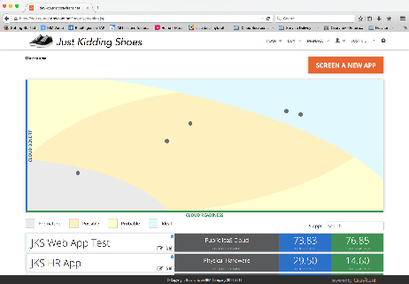
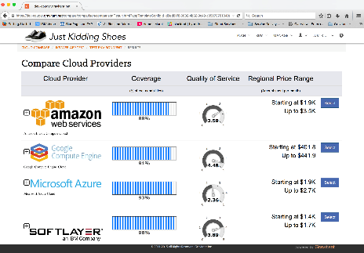
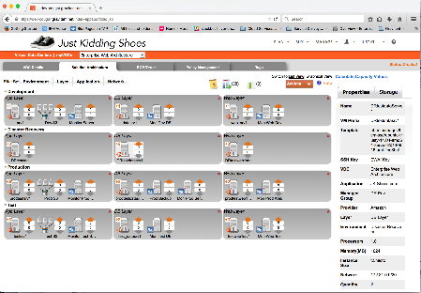
Workload Planning, Design, Cost Estimation and Sourcing
Target Deployment
Cloud Benefit Score
Cloud Readiness
Coverage and Capabilities
QoS via 3rd party Benchmarks
Client specific costs
Details for each application tier
Details for Dev, Test, Prod, DR
Includes IBM Managed Services
Sandy
(Solution Architect)
Assess Application
Compare Cloud Providers
Estimate Solution Cost
Brokerage
Orchestration
Operations
Traditional On-premises IT Client-based
Private Cloud Client-based
Public Cloud IBM
Public Cloud AWS
Public Cloud Azure
Public Cloud Other, etc.

Slide 22
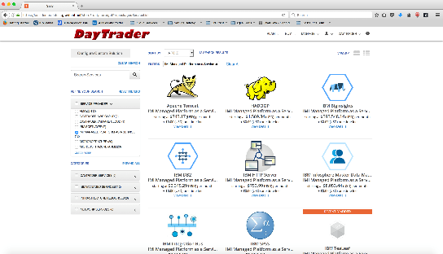
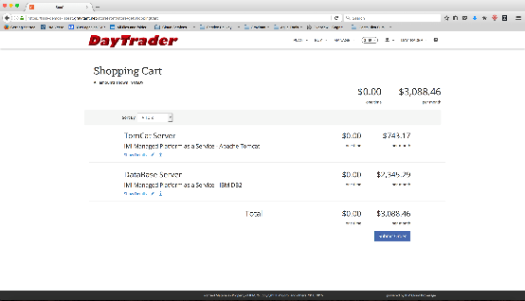
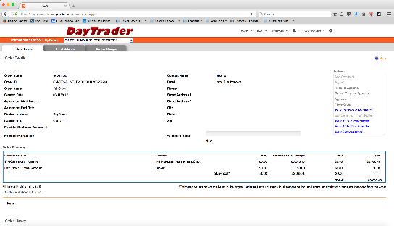
Broker Store: Self-Service Consumptions of Hybrid Cloud Services
George
(LOB Consumer)
Browse Marketplace
View Cart; Place Order
Track Order
Brokerage
Orchestration
The simplicity of on-line shopping for IT…..
Operations
Find what you are looking for…..
know how much it will cost….
Track it’s delivery…
Traditional On-premises IT Client-based
Private Cloud Client-based
Public Cloud IBM
Public Cloud AWS
Public Cloud Azure
Public Cloud Other, etc.

Slide 23
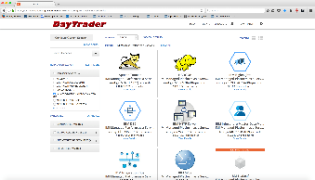


What is happening behind the Self-Service Experience
Self-Service Consumption Experience
What you see
Browse Services
Select Services
Order Services
George
LOB Consumer
Order Approvals
Auto Approved via Policy
policy
Approval
Service Fulfillment
Orchestrated Fulfillment
Service Fulfillment Bridge
What you don’t see
ICO
vRealize
IBM Cloud Deployment Services
ServiceNow
other integrations…

Slide 24

What is happening with the DevOps + Brokerage Experience
DevOps Experience
What you see
Continuous Integrations
Continuous Deployment
Order Services
George
LOB Consumer
Order Approvals
Auto Approved via Policy
policy
Approval
Service Fulfillment
Orchestrated Fulfillment
Service Fulfillment Bridge
What you don’t see
ICO
vRealize
IBM Cloud Deployment Services
ServiceNow
other integrations…

Slide 25
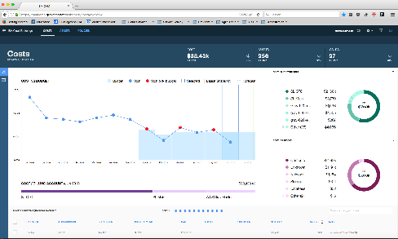
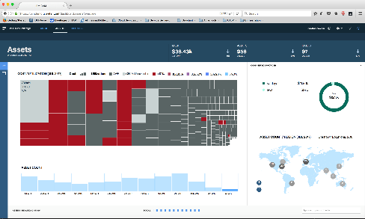
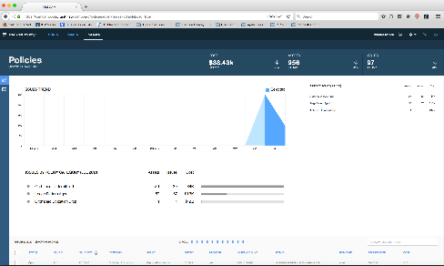
Broker CAM: Managed Cloud Assets, Costs and Policies
Trends relative to Budgets
Drills down by Provider & Category
Invoice Line Item Details
Cost/Utilization Heat Maps
Asset Count Trends
Regional Views
Issue Trends
Issue Breakdown by Policy
Identify Underutilization Trends
Jack
(Financial Analyst)
View and Manage Cost
View and Manage Assets
View and Manage Policies
Brokerage
Orchestration
Operations
Traditional On-premises IT Client-based
Private Cloud Client-based
Public Cloud IBM
Public Cloud AWS
Public Cloud Azure
Public Cloud Other, etc.

Slide 26
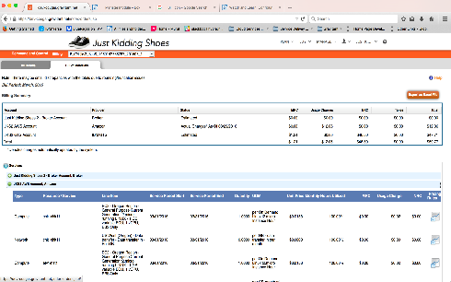
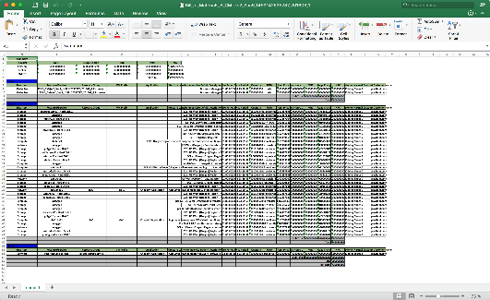
Unified Billing Management and Billing Reconciliation
Broker Finance Application is a Roadmap Item for 2018
View of all Customers
View by Account
View by Services
Import Bills from Providers
Apply Marketplace Pricing
Update Budgets and Dashboards
Export from the Broker
Import into external Financial System
Reconciliation
Jack
(Financial Analyst)
View Estimated Bills
Billing Automation
Export Bills
Brokerage
Orchestration
Operations
Traditional On-premises IT Client-based
Private Cloud Client-based
Public Cloud IBM
Public Cloud AWS
Public Cloud Azure
Public Cloud Other, etc.

Slide 27
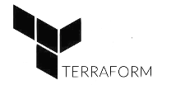
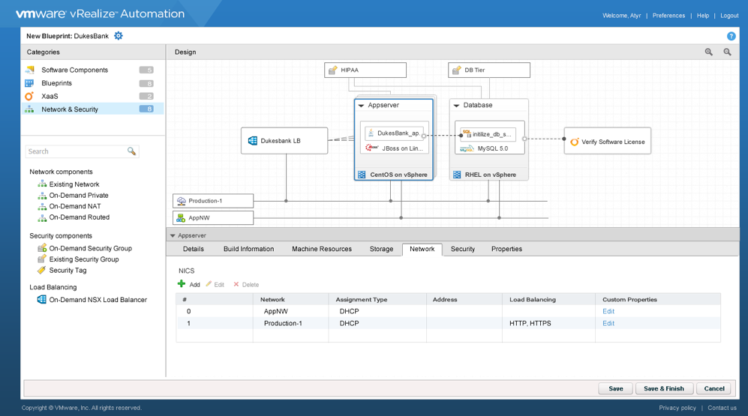

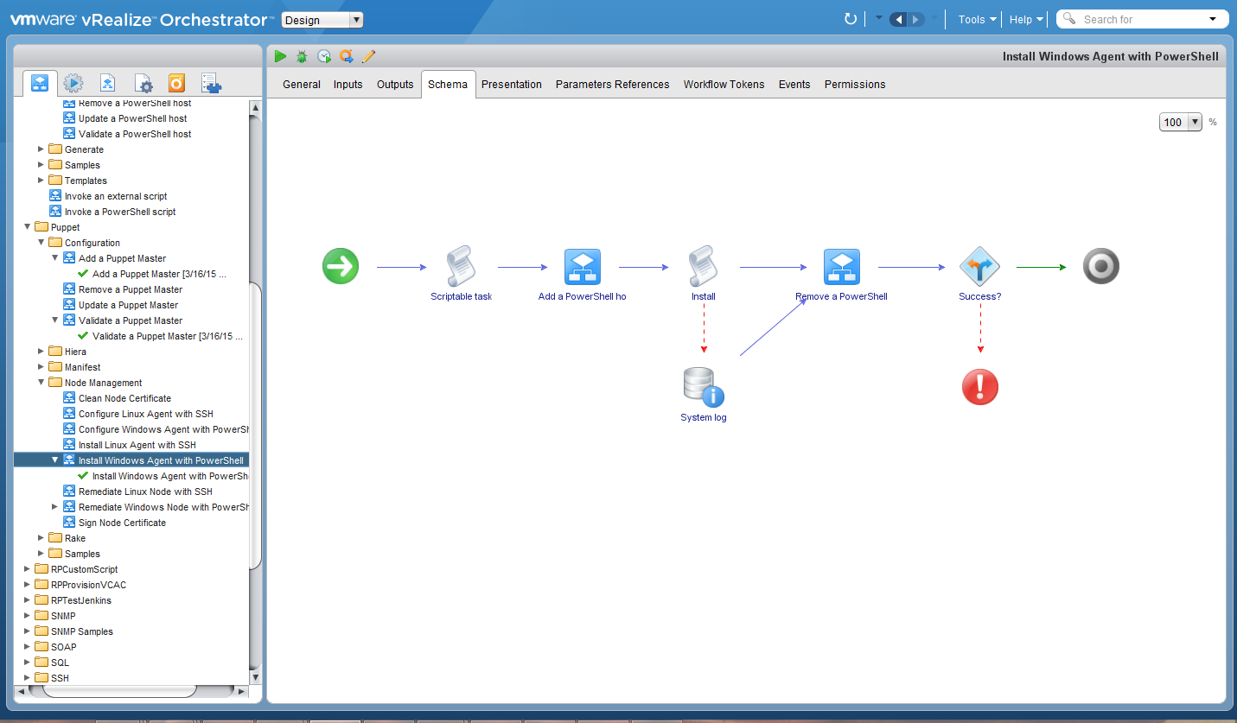
IBM Cloud Deployment Services
A fully managed orchestration and automation platform powered by enterprise-ready standard blueprints encapsulating managed services and integrated with enterprise IT-as-a-Service (ITaaS) capabilities...
Sandy
(Solution Architect)
Brokerage
Carl
(Content Developer)
Orchestration
Pattern (Blueprints)
Support for ICP/CAM
(IBM Lead With Solution)
Support for vRealize
Pattern Factory
Software Configuration Management
Workflow Orchestration
Operations
Traditional On-premises IT Client-based
Private Cloud Client-based
Public Cloud IBM
Public Cloud AWS
Public Cloud Azure
Public Cloud Other, etc.

Slide 28
IBM Cloud: The Big Picture and Positioning of IBM Cloud Private (ICP)
Yesterday / Today...
Strategic...
IBM Cloud DevOps
IBM Bluemix Shared
IBM Cloud DevOps
IBM
Public Cloud
“AWS Model”
Public
Virtual Private
IBM Bluemix Dedicated
Virtual Private
Kubernetes Containers and Cloud Foundry are the key abstraction shared between Public and Private Cloud
IBM Bluemix
Local
WAS
CAM
…
DB2
MQ
…
“Azure Stack Model”
Public
On-Premise Private
Others in this space…
VWware
Pivotal
RedHat
Client or GTS Ops
IBM Cloud private
IBM Bluemix Local has been problematic…
Tethered Management Problematic
Large Footprint and associated Cost
Lacking Many Services (e.g. Watson Services)
Lacking Enterprise Readiness
BYO IaaS
28

Slide 29
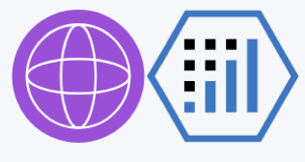
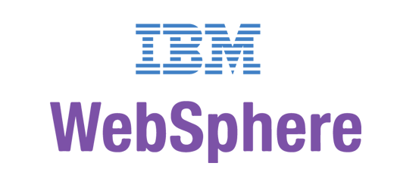

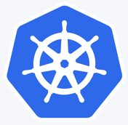
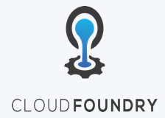
IBM Cloud Private: Cloud Native platform with Enterprise grade content
IBM Middleware, Data, Analytics, Management and Developer Services
Cloud enabled middleware, messaging, databases, analytics, and cognitive services to optimize current investments while rapidly innovating
Enterprise grade services for Middleware, Data, Analytics, DevOps
DevOps
Open Source
Core Operational Services Simplify Operations Management, Security, and Hybrid integration Provision infrastructure and apps across Multi-Cloud environments
Enterprise grade operations, across your Hybrid IT environment
Kubernetes-based Container Platform
Industry leading container orchestration platform across private, dedicated & public clouds
Cloud Foundry
For prescribed app development & deployment
Open by design, preventing vendor lock-in
Leverage existing investments
Runs on existing IaaS:
System Z
IBM Spectrum
CMS
Third Party alliances:
Dell Cisco NetApp Lenovo Canonical …
29
Notes:
Graphical view of the capabilities – talk through the layers
… plus, CAM capability for multi-cloud orchestration
*****

Slide 30
Cloud Automation Manager (CAM) for IBM Cloud Private
CAM is a Component of IBM Cloud Private that is critical to our GTS Multi-Cloud Strategy
Cloud Automation Manager
Containerized cloud native application
Installed into an IBM Cloud Private worker node with a Helm chart
Leverages IBM Cloud Private services for enterprise capabilities
Built with open source technology
Template Library
Workload Automation
Service Composition &
Orchestration
Instance
Management
Multi-cloud management services
IBM Cloud Private
Self-service catalog
Multi-cloud
Infrastructure
Infrastructure
Data & Analytics Services
Core Services
Kubernetes
Databases
Analytics
CAM
IAM
Logging
Audit
API & Data Connect
Encryption & Key Management
Monitoring
Usage
Metering
Event
Tenant Svcs
30
Notes:
Graphical view of the capabilities – talk through the layers
… plus, CAM capability for multi-cloud orchestration
*****

Slide 31
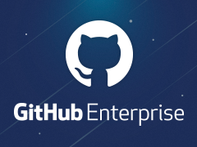
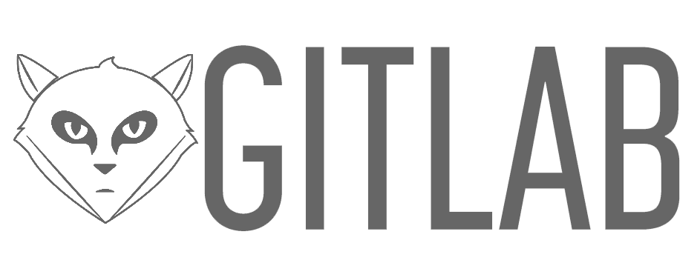


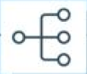
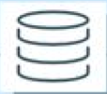
Cloud Automation Manager (CAM): Use cases
CAM is a Component of IBM Cloud Private that is critical to our GTS Multi-Cloud Strategy
Automate and standardize delivery of infrastructure and application stacks consistently in many clouds
Compose and orchestrate complex environments into easy to consume cloud services that can be accessed with a DevOps tool chain or published into a self-service catalog
Manage workload and service instance lifecycle across many clouds
Deployment & Process Orchestration
Service
Composer
3rd Party Integrations
Flow Engine
Template Library
Template Management
Instance Management
Template API
Workload
Terraform
K8s Helm
Service
Multi-cloud Management Services
CAM is the successor to IBM Cloud Orchestration (ICO) that is being solution for new clients and the strategic replacement platform for existing ICO Clients.
31
Notes:
Graphical view of the capabilities – talk through the layers
… plus, CAM capability for multi-cloud orchestration
*****

Slide 32
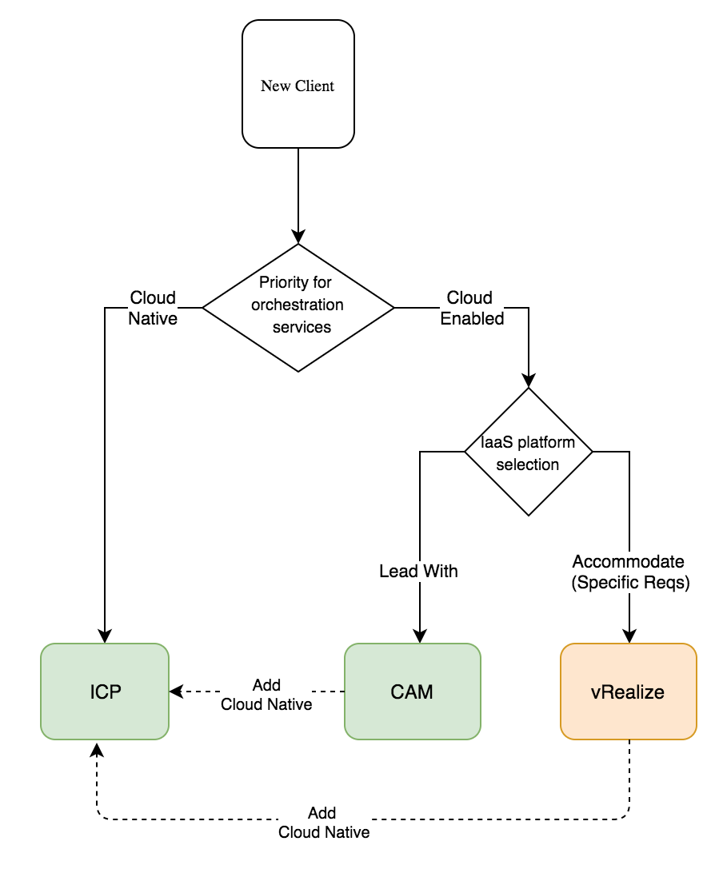
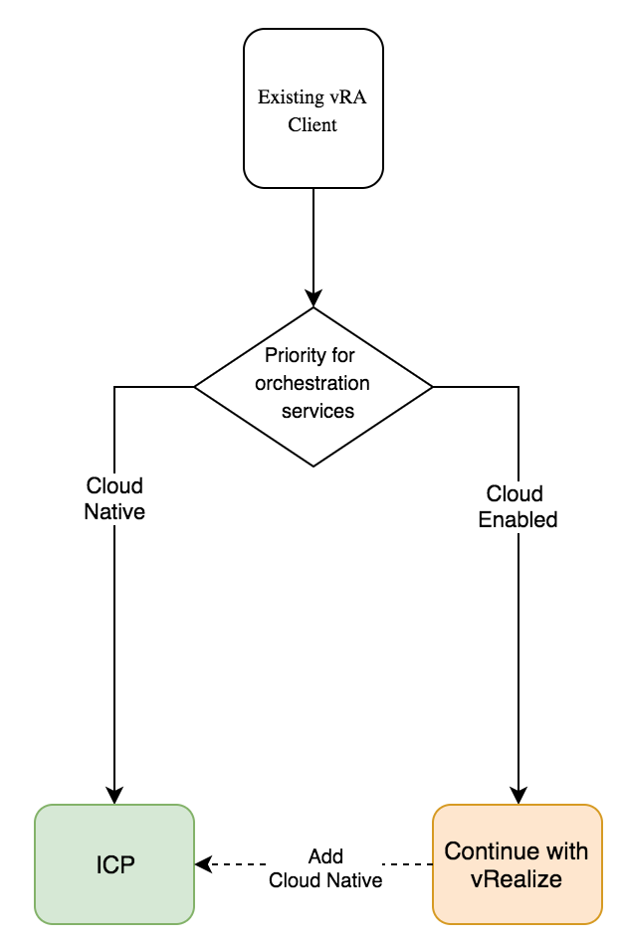
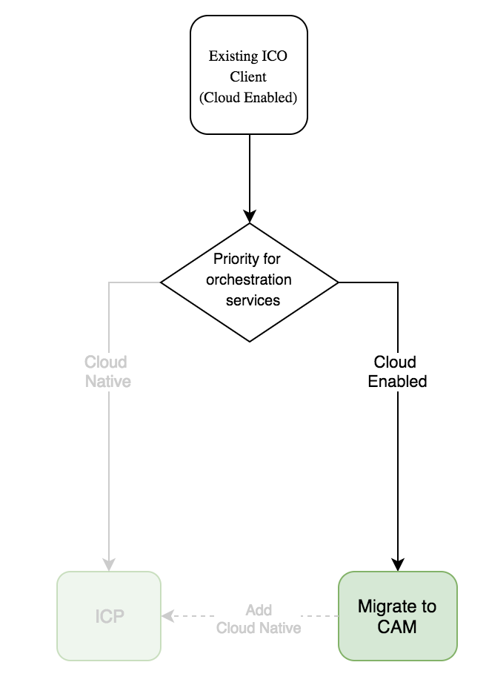
Hybrid Cloud Orchestration Decision Tree
Guidance Provided to the Global Solution Integration Hubs
New Clients
vRealize Clients
Existing ICO Clients

Slide 33
IBM Cloud Deployment Services
Treating Patterns as Code...
Micro-Patterns
Allowing Variability through Compositions
Today’s Monolithic Patterns
Linux a
WAS a
Monitoring
Monitoring
Monitoring
Backup
DB/2 y
Windows x
Monitoring
Monitoring
WAS b
Linux a
Backup
Linux b
WAS b
Backup
WAS b
DB/2 y
Windows x
DB/2 x
Patch
Linux a
Windows x
Much of today’s content is built in a more monolithic fashion that does not support the flexibility and variability that is required in the field.
Windows y
DB/2 y
Availability
Primary Owner: Client (or GTS on behalf of the Client)
…
…
…
Primary Owner: CSP
Primary Owner: Cloud
Primary Owner: GTS
Software Engineering Practices need to be applied to the development of content…
variability driven by client application requirements
variability driven by IBM Managed Services
Better encapsulation to avoid code changes for client configurations
By-Reference vs. By-Value where ever possible
Micro-Patterns assembled together into compositions
Data-Drive pattern generation
Standardization of what we own (e.g. management services)
Incorporate better serviceability within content (e.g. trace, log)
Alignment with architectural layers to isolation churn with technology changes
Micro-Services concepts applied to the development of pattern content….

Slide 34






IBM Cloud Deployment Services
Developing Patterns and Catalog Content within the Pattern Factory
on-boards service and resource descriptions
Service Registry
Manage Content
Chloe
(Content Manager)
A declarative approach, allowing all services to be expressed as resource in patterns...
develops micro-patterns
Git
Develop Micro-Patters
Carl
(Pattern Developer)
Composes Solution Blueprints
Git
Publishes Solution Blueprint
Broker Catalog
Compose Solution Blueprints
Sandy
(Solution Architect)
Orders Service
Solution Blueprint
Configure Order
Solution Blueprint
Instance Data
Configuration
Orchestration Engine
+
George
(Application Owner)
Consumes Services

